Slide 1
软件体系结构
10 可伸缩软件架构
刘旭东
cameran@hit.edu.cn
Saturday, November 7, 2026

Slide 2
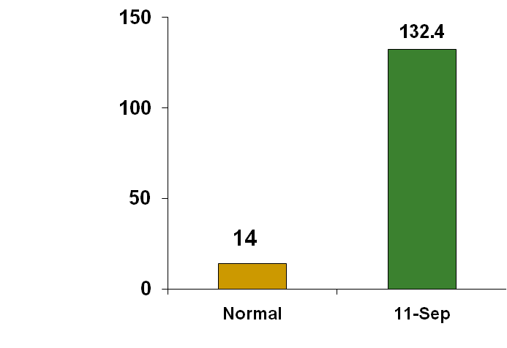
案例1：2001年美国911事件
CNN.com
Daily page views
(in millions)
CNN, NY Times, ABC News
unavailable from 9-10 AM
(Eastern Time)

Slide 3

案例2：淘宝双十一事件
2010年11月11日，淘宝推出5折优惠的促销活动，2100万人参与，单日成交9.39亿。但是对于这种爆发性流量，超出了淘宝系统的承受能力，被迫停掉“确认收货”业务。
Notes:
淘宝双十一事件infoQ专访http://www.infoq.com/cn/interviews/taobao-1111-technique
2011年淘宝双十一数据参见http://www.100ec.cn/detail--6011170.html

Slide 4
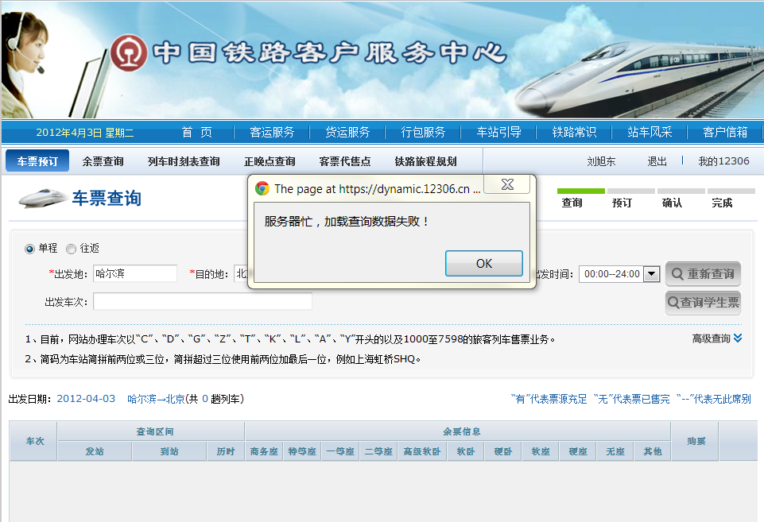
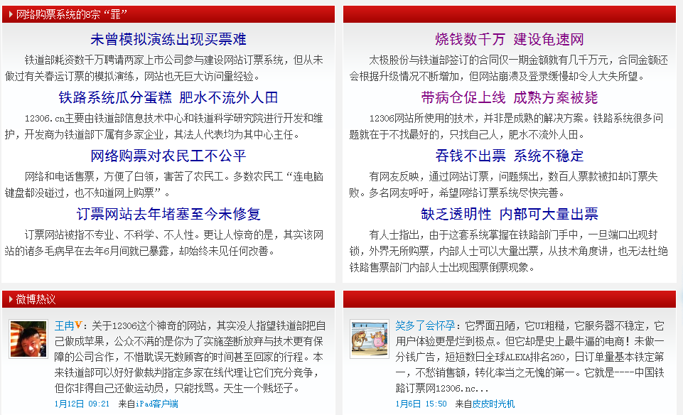
案例3： “龟速网?” 12306铁道部火车票订票网站
2012年1月1-7日，“12306”网站日均点击次数已经超过了10亿次 ,1月9日下午6时许，该网站页面打开速度仍明显慢于其他网站，网站一度无法登录。

Slide 5
更多案例
1999年6月，eBay发生长达22 小时当机事件，连带使eBay股价惨跌，五天内跌了将近26%；那一次当机，使公司第二季营收少掉500万美元。
2001年1月4日, eBay当机21 小时.
2005年5月14日，Google当机1小时.
2009年8月4日,PayPal全球当机1小时.
2010年9月,Facebook当机数小时
2010年12月1日，新浪微博当机将近1小时.
…

Slide 6
What is wrong with the SA？
Scalability
High Availability

Slide 7
Scalability
Scalability is the ability of a system to handle growing amount of work in a capable manner (适应不断增长的处理任务的能力).
Scale vertically(垂直扩展)
  To scale vertically (or scale up) means to add resources to a single node in a system, typically involving the addition of CPUs or memory to a single computer.(提高硬件配置)
Scale horizontally(水平扩展)
  To scale horizontally (or scale out) means to add more nodes to a system, such as adding a new computer to a distributed software application.(增加新的计算机分布式计算)
Notes:
Such vertical scaling of existing systems also enables them to use virtualization technology more effectively,
as it provides more resources for the hosted set of operating system and application modules to share.(可通过虚拟机扩展系统资源)

Slide 8
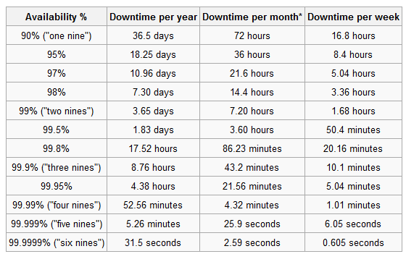
High availability
High Availability means the system has the ability to ensure the its services are accessible with reasonable/predictable response times at any time.(系统在几乎任何时刻都可被正常访问)
Availability is usually expressed as a percentage of uptime in a given year (通常量化为一年中正常运行的时间比).

Slide 9
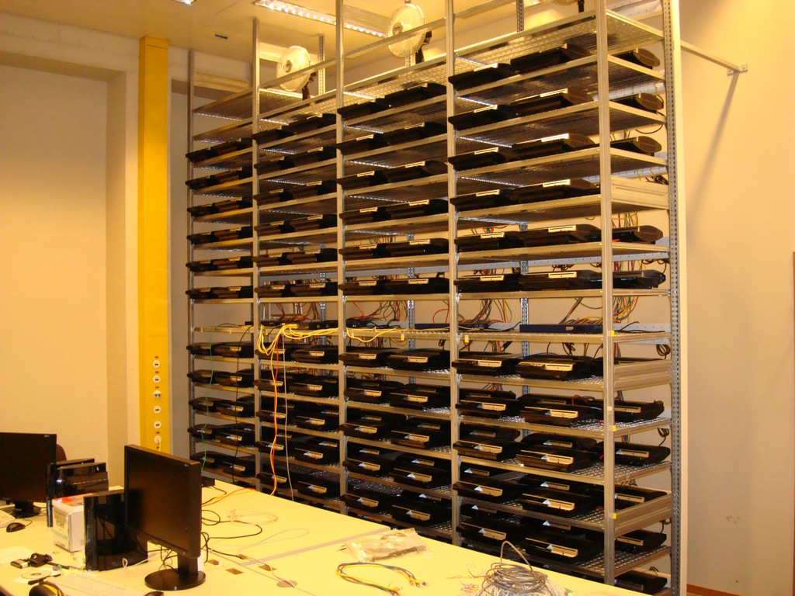

How?
Clustering

Slide 10
主要内容
集群的概念
  集群
  负载均衡
  会话粘连
  失效转移
  单点故障
构建可伸缩架构
  11 steps
大型网站案例
  淘宝
  YouTube
  天涯社区
集群技术实战
  Nginx+Tomcat+Memcached+Cobar+MySQL
点对点架构

Slide 11
10.1 集群的概念
Concept of Clustering

Slide 12
Cluster(集群)
A computer cluster consists of a set of loosely connected computers that work together so that in many respects they can be viewed as a single system. (一组松散的服务器，共同协作，可被看作是一台服务器)
The components of a cluster are usually connected to each other through fast local area networks, each node running its own instance on an operating system(通过高速局域网互联,每个节点运行独立实例).
Computer clusters emerged as a result of convergence of a number of computing trends including the availability of low cost microprocessors, high speed networks, and software for high performance distributed computing (低成本硬件搭建高性能分布式计算).

Slide 13
Distributed computing(分布式计算)
Distributed computing refers to the use of distributed systems to solve computational problems. A distributed system consists of multiple autonomous computers that communicate through a computer network. The computers interact with each other in order to achieve a common goal.(多台互联的计算机协作解决一个问题)
In distributed computing, a problem is divided into many tasks, each of which is solved by one or more computers(分而治之).
Distributed computing has become increasingly common due advances that have made both machines and networks cheaper and faster. Since the early 1990s, an increasing trend to move away from expensive and specialized proprietary parallel supercomputers towards clusters of workstations. (随着硬件越来越便宜,分布式计算成为高性能计算趋势)

Slide 14
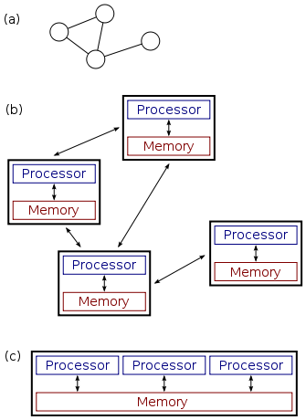
Distributed & Parallel computing(分布&并行计算)
In parallel computing, all processors have access to a shared memory. Shared memory can be used to exchange information between processors.(通过共享内存交换讯息)
In distributed computing, each processor has its own private memory (distributed memory). Information is exchanged by passing messages between the processors.(自治计算机,通过消息传递交换信息)
(a)–(b) A distributed system.
(c) A parallel system.

Slide 15
Clustering(集群)
Cluster is an effective way to resolve the scalability issue. It allows a group of servers to share the heavy tasks, and operate as a single server logically (集群是可伸缩性的有效方法).
Clustering is a solution to achieve high availability by providing redundant servers in the cluster in case one server fails to provide service (集群是实现高可用性的有效方法).

Slide 16
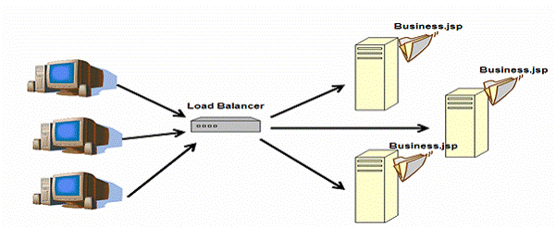
Load balancing(负载均衡)
Load balancing is one of the key technologies behind clustering, which is a way to obtain high availability and better performance by dispatching incoming requests to different servers.(通过把并发请求分发给不同的服务器，从而获得高可用性和较好的性能)
The load balancing service is usually provided by dedicated software or hardware, such as a multilayer switch or a Domain Name System server.(可由软件或硬件实现)
the load balancer normally has the following features:
  Request dispatch
  Session stickiness
  Health check & Failover

Slide 17
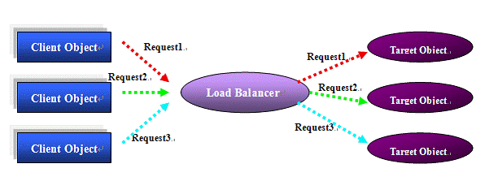
Requests dispatch(请求分配)
When client requests comes, the load balancer will decide how to dispatch the requests to the backend server instances.(请客户请求按一定策略分发给集群中的某个节点)
Popular algorithms include Round-Robin, Random and Weight Based (静态分配策略).
Some sophisticated load balancer implements special algorithm which will detect every server’ works load before dispatching the requests to the servers (按负载动态分配).

Slide 18
Session stickiness (回话粘连)
When load balancing, it is the best choice to dispatch the request to the same server instance as the last time for a certain browser session. Otherwise, the application may not work properly (将属于同一个session的请求分配给上次请求的服务器实例，否则，应用程序可能不能正确工作).
Because the HTTP protocol is itself stateless, session state needs to be stored somewhere and associated with your browsing session in a way that can be easily retrieved the next time you request a page from the same Web application (HTTP为无状态的协议，在WEB应用服务器端通过session保存状态数据).
Nearly every Web application has some session state, which might be as simple as remembering whether you are logged in, or the contents of your shopping cart (例如购物车、用户登录信息等是状态数据).

Slide 19
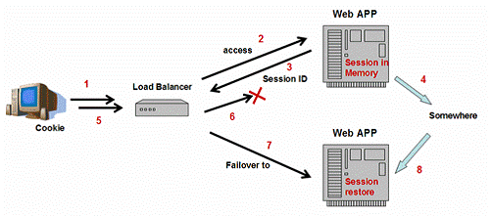
Health check & Failover(健康检查与失效转移)
Health check(健康检查)
  When some server instance fails, the load balancer should detect this failure and never dispatch requests to it any more. The load balancer also needs to monitor when the failed server comes back, and resume dispatching requests to it. (检查集群中节点是否可用以保证请求能够被处理)
Failover(失效转移)
  when a server instance fails, the service is still available, because new requests can be handled by other redundant server instances in the cluster (集群中某节点失效，该节点上处理的请求能够被其他节点正确地接手处理).

Slide 20
SPOF(单点故障)
The single point of failure (SPOF) is a part of a system that, if it fails, will stop the entire system from working. (能够导致整个系统停止运行的模块)
Systems can be made robust by adding redundancy in all potential SPOFs (可通过冗余消除单点故障).

Slide 21
10.2 构建可伸缩架构
Building a Scalable Architecture

Slide 22
Steps
Inspect current Architecture
  Identify Scalability Bottlenecks (找出性能瓶颈)
  Identify SPOFs and Availability Issues (找出单一故障点)
  Identify Downtime Impact Risk Zones (找出当机影响区域)
Apply one of following(水平/垂直扩展/切分)
  Vertical Scaling
  Vertical Partitioning
  Horizontal Scaling
  Horizontal Partitioning
Repeat process

Slide 23
Step 1 – Lets Start …
Suppose your system (e.g. your Blog system), deployed on a single server, need to scale…
Appserver, DBServer
CPU
RAM

Slide 24
Step 2 – Vertical Scaling
Increase CPU and RAM…
Simple to implement
Disadvantages
  Finite limit
  Hardware does not scale linearly
  Requires downtime
  Increases Downtime Impact
  Incremental costs increase exponentially
Appserver, DBServer
CPU
CPU
RAM
RAM

Slide 25
Step 3 – Vertical Partitioning (Services)
Deploying each service on a separate node
Advantages
  Increases per application Availability
  Task-based specialization, optimization and tuning possible
  Simple to implement
  No changes to App required
Limitations
  Requires downtime
  May not increase overall availability
  Finite Scalability
AppServer
DBServer

Slide 26
Step 4 – Horizontal Scaling (App Server)
Clustering
  Increasing the number of nodes of the App Server through Load Balancing
Implementation
  Hardware Load balancers are faster
  Software Load balancers are more customizable
  With HTTP Servers load balancing is typically combined with http accelerators
  Session management policy for failover (会话管理策略)
Load Balancer
AppServer
AppServer
AppServer
DBServer

Slide 27
Load Balancer – Session Management Policy
Central Session Storage
  Introduces SPOF(引入单点故障)
  An additional variable
  Session reads and writes Disk + Network I/O (性能略微下降)
  Also known as a Shared Session Store Cluster (session也可集群)
Load Balancer
AppServer
AppServer
AppServer
Session Store

Slide 28
Load Balancer – Session Management Policy
Clustered Session Management
  Easier to setup
  No SPOF
  Session reads are instantaneous
  Session writes generate Network I/O
  Network I/O increases exponentially with increase in number of nodes
  In very rare circumstances a request may get stale session data
    User request reaches subsequent node faster than intra-node message
    Intra-node communication fails
  AKA Shared-nothing Cluster
Load Balancer
AppServer
AppServer
AppServer

Slide 29
Load Balancer – Session Management Policy
Recommendation
  Use Clustered Session Management if you have –
    Smaller Number of App Servers
    Fewer Session writes
  Use a Central Session Store elsewhere
  Use sticky sessions only if you have to

Slide 30
Load Balancer – Removing SPOF
Setup LB in Active-Active or Active-Passive mode cluster, because LB may be an SPOF.(LB集群解决LB自身单点故障问题)
  Note: Active-Active nevertheless assumes that each LB is independently able to take up the load of the other
  If one wants ZERO downtime, then Active-Active becomes truly cost beneficial only if multiple LBs (more than 3 to 4) are daisy chained as Active-Active forming an LB Cluster
Active-Passive LB
Users
Load Balancer
Load Balancer
AppServer
AppServer
AppServer
Active-Active LB
Users
Load Balancer
Load Balancer
AppServer
AppServer
AppServer
Notes:
Active Node. When a node is active, it is actively handling requests.
Passive Node. When a node is passive, it is idle, on standby waiting for another node to fail.

Slide 31
Step 5 – Vertical Partitioning (Hardware)
Partitioning out the Storage function using a SAN (利用SAN存储数据库)
Positives
  Allows “Scaling Up” the DB Server
  Boosts Performance of DB Server
Negatives
  Increases Cost (SAN设备比较昂贵)
Load Balanced
App Servers
DBServer
SAN
SAN (Storage Area Network)即存储区域网络。它是一种通过光纤集线器、光纤路由器、光纤交换机等连接设备将磁盘阵列、磁带等存储设备与相关服务器连接起来的高速专用子网，是一种高性能存储系统。

Slide 32
Step 6 – Horizontal Scaling (DB)
Scaling out the DB Server (数据库集群)
  Shared nothing Cluster
  Real Application Cluster (or Shared Storage Cluster)
Load Balanced
App Servers
DBServer
DBServer
DBServer
SAN
Notes:
A shared nothing architecture (SN) is a distributed computing architecture in which each node is independent and self-sufficient, and there is no single point of contention across the system. More specifically, none of the nodes share memory or disk storage.
A partition is a division of a logical database or its constituting elements into distinct independent parts. Database partitioning is normally done for manageability, performance or availability reasons.
Vertical partitioning involves creating tables with fewer columns and using additional tables to store the remaining columns.
Horizontal partitioning (also see shard) involves putting different rows into different tables.
A database shard is a horizontal partition in a database or search engine. Each individual partition is referred to as a shard or database shard.

Slide 33
Mode1: Shared nothing Cluster
Each DB Server node has its own complete copy of the database (所有数据库实例都相同)
Nothing is shared between the DB Server Nodes
This is achieved through DB Replication at DB / Driver / App level or through a proxy(通过数据库复制实现)
Supported by most RDBMs natively or through 3rd party software
DBServer
DBServer
DBServer
Database
Database
Database
Note: Actual DB files maybe stored on a central SAN
Notes:
Oracle RAC

Slide 34
Replication Considerations
Master-Slave (一主多子模式)
  Writes are sent to a single master which replicates the data to multiple slave nodes
  Replication maybe cascaded
  Simple setup
  No conflict management required
Multi-Master(多主多子模式)
  Writes can be sent to any of the multiple masters which replicate them to other masters and slaves
  Conflict Management required Deadlocks possible if same data is simultaneously modified at multiple places

Slide 35
Replication Considerations
Asynchronous(异步复制)
  Master updates its own db and returns a response to client (不等待复制完成直接响应客户)
  Replication from Master to Slave takes place asynchronously
  Faster response to a client
  Slave data is marginally behind the Master
  Requires modification to App to send critical reads and writes to master, and load balance all other reads(需要修改程序，并对slave节点进行负载均衡)
Synchronous(同步复制)
  Master updates its own db, and confirms all slaves have updated their db before returning a response to client
  Slower response to a client
  Slaves have the same data as the Master at all times
  Requires modification to App to send writes to master and load balance all reads

Slide 36
Replication Considerations
Replication at RDBMS level (DBMS级复制)
  Support may exists in RDBMS or through 3rd party tool
  Faster and more reliable
  App must send writes to Master, reads to any db and critical reads to Master
Replication at Driver / DAO level (应用程序级复制)
  Driver / DAO layer ensures
    writes are performed on all connected DBs
    Reads are load balanced
    Critical reads are sent to a Master
  In most cases RDBMS agnostic (对DBMS透明)
  Slower and in some cases less reliable (性能不佳且不可靠)

Slide 37
Mode2: Real Application Cluster(实时应用集群)
Also called share everything cluster
All DB Servers in the cluster share a common storage area on a SAN (所有的数据库服务器在SAN中共享一个存储区域)
All DB servers mount the same block device
The file system must be a clustered file system (e.g. GFS / OFS)
Currently only supported by Oracle Real Application Cluster (Oracle RAC)
Can be very expensive (licensing fees)
DBServer
DBServer
DBServer
SAN
Database

Slide 38
Recommendation
Try and choose a DB which natively supports Master-Slave replication(数据库本身支持主从复制模式)
Use Master-Slave Async replication(异步复制)
Write your DAO layer to ensure
  writes are sent to a single DB
  reads are load balanced
  Critical reads are sent to a master
Load Balanced
App Servers
DBServer
DBServer
DBServer
Writes & Critical Reads
Other Reads

Slide 39
Step 6 – Horizontal Scaling (DB)
The architecture now looks like this
Positives
  As Web servers grow, Database nodes can be added
  DB Server is no longer SPOF
Negatives
  Finite limit
Load Balanced
App Servers
DB Cluster
DB
DB
DB
SAN

Slide 40
Finite limit
Reads
Shared nothing clusters have a finite scaling limit (slave节点复制代价高)
  Reads to Writes – 2:1(假设读写比例为2:1)So 8 Reads => 4 writes
  2 DBs
    Per db – 4 reads and 4 writes
  4 DBs
    Per db – 2 reads and 4 writes
  8 DBs
    Per db – 1 read and 4 writes
At some point adding another node brings in negligible incremental benefit
Writes
DB1
DB2

Slide 41
Step 7 – Vertical / Horizontal Partitioning (DB)
Increasing the number of DB Clusters by dividing the data (数据切分)
  Vertical Partitioning - Dividing tables / columns(垂直切分)
  Horizontal Partitioning - Dividing by rows (value)(水平切分)

Slide 42
Vertical Partitioning (DB)
Take a set of tables and move them onto another DB(分表)
Each DB Cluster has different tables(每个数据库节点中的表都不一样)
Application code or DAO / Driver code or a proxy knows where a given table is and directs queries to the appropriate DB (程序需调整)
Can also be done at a column level by moving a set of columns into a separate table(也可以拆表)
Negatives：
  One cannot perform SQL joins or maintain referential integrity (referential integrity is as such over-rated) (不能做join操作,代价太大)
  Finite Limit
App Cluster
DB Cluster 1
Table 1
Table 2
DB Cluster 2
Table 3
Table 4
  E.g. in a social network - the users table and the friends table can be on separate DB clusters

Slide 43
Horizontal Partitioning (DB)
Take a set of rows and move them onto another DB(分数据)
Each DB Cluster has identical tables(每个数据库拥有相同的表)
Application code or DAO / Driver code or a proxy knows where a given row is and directs queries to the appropriate DB(程序需修改)
Negatives
  SQL unions for search type queries must be performed within code
App Cluster
DB Cluster 1
Table 1
Table 2
Table 3
Table 4
DB Cluster 2
Table 1
Table 2
Table 3
Table 4
1 million users
1 million users
  E.g. in a social network – each DB Cluster can contain all data for 1 million users
Creative Commons Sharealike Attributions Noncommercial

Slide 44
Horizontal Partitioning Policy
FCFS
  1st million users are stored on cluster 1 and the next on cluster 2
Round Robin
Least Used (Balanced)
  Each time a new user is added, a DB cluster with the least users is chosen
Hash based
  A hashing function is used to determine the DB Cluster in which the user data should be inserted
Value Based
  User ids 1 to 1 million stored in cluster 1 OR
  all users with names starting from A-M on cluster 1
Except for Hash and Value based all other techniques also require an independent lookup map – mapping user to Database Cluster. This map itself will be stored on a separate DB (which may further need to be replicated) (除了Hash和基于值的切分策略，其他策略需设置专门数据库存储数据切分信息)

Slide 45
Step 7 – Vertical / Horizontal Partitioning (DB)
The architecture now looks like this
Positives
  As App servers grow, Database Clusters can be added (应用和数据均可扩展)
Note: This is not the same as table partitioning provided by the db (eg MSSQL)
Load Balanced
App Servers
Lookup
Map
DB Cluster
DB Cluster
DB
DB
DB
DB
DB
DB
SAN
Creative Commons Sharealike Attributions Noncommercial

Slide 46
Step 8 – Separating Sets
Now we consider each deployment as a single Set serving a collection of users
Global
Lookup
Map
Global Redirector
Load Balanced
App Servers
Load Balanced
App Servers
Lookup
Map
Lookup
Map
DB Cluster
DB Cluster
DB Cluster
DB Cluster
DB
DB
DB
DB
DB
DB
DB
DB
DB
DB
DB
DB
SAN
SAN
SET 1 – 10 million users
SET 2 – 10 million users

Slide 47
Creating Sets
The goal behind creating sets is easier manageability
Each Set is independent and handles transactions for a set of users (每个部署集面向不同用户群)
Each Set is architecturally identical to the other (每个部署集在体系结构上是一样的)
Each Set contains the entire application with all its data structures (每个部署集都有完整的应用及数据结构)
Sets can even be deployed in separate datacenters(每个部署集部署于单独的数据中心)
Users may even be added to a Set that is closer to them in terms of network latency(用户可能按网络延迟被分配到较近的部署集上)

Slide 48
Step 8 – Horizontal Partitioning (Sets)
The architecture now looks like this
Positives
  Infinite Scalability
Negatives
  Aggregation of data across sets is complex (数据集成)
  Users may need to be moved across Sets if sizing is improper(数据转移)
  Global App settings and preferences need to be replicated across Sets(数据复制)
Global Redirector
App Servers
Cluster
App Servers
Cluster
DB Cluster
DB Cluster
DB Cluster
DB Cluster
SAN
SAN
SET 1
SET 2

Slide 49
Step 9 – Caching
Add caches within App Server
  external cache
    Cache outbound HTTP objects, e.g. Images, CSS, XML, HTML, etc…
    Squid, Apache’s mod_proxy. etc.
  Internal cache
    Application objects. e.g. objects mapping to database table
    Memcached, Redis. etc.
Load Balancer
AppServer
AppServer
AppServer
Ext Cache
Ext Cache
Ext Cache
Int Cache
Int Cache
Int Cache
Session Store
Notes:
Depending on the type of HTTP response being made, the Caching Tier may decide to store the object for future use. As soon as another request is made for the same object, the Caching Tier may decide to reuse the previous object, saving a round trip to the next layer.
On other occasions, the Caching Tier may ignore the local object entirely and force a refresh of the object from the backend. All of these semantics are governed by the HTTP spec.
Windows下的memcached
http://code.jellycan.com/memcached/

Slide 50
Step 10 – Reverse proxy/HTTP Accelerator
A good Reverse proxy / HTTP Accelerator performs the following
  Redirect static content requests to a lighter HTTP server (lighttpd)
  Cache content based on rules (with granular invalidation support)
  Use Async NIO on the user side
  Intelligent load balancing
Solutions
  Nginx
  Perlbal
  Hardware accelerators plus Load Balancers

Slide 51
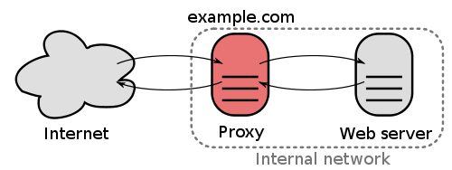
Reverse Proxy(反向代理)
A reverse proxy is (usually) an Internet-facing proxy used as a front-end to control and protect access to a server on a private network, commonly also performing tasks such as load-balancing, authentication, decryption or caching.(反向代理控制客户端对服务器机群的访问，并且通常提供负载均衡、安全、加密以及缓存等服务)
  Reverse proxies can be used whenever multiple web servers must be accessible via a single public IP address.
  Application firewall features can protect against common web-based attacks.
  SSL encryption can be offloaded to a reverse proxy.
  A reverse proxy can distribute the load from incoming requests to several servers
  A reverse proxy can reduce load on its origin servers by caching static content, as well as dynamic content. Another term for this is web accelerator.
  A reverse proxy can optimize content by compressing it in order to speed up loading times.
  …

Slide 52
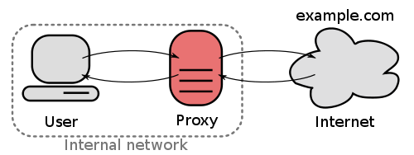
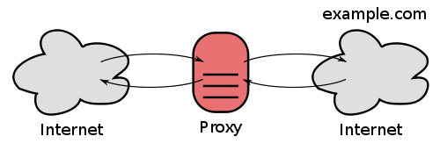
Proxy server(代理服务器)
A proxy server is a server (a computer system or an application) that acts as an intermediary for requests from clients seeking resources from other servers.
  A forward proxy taking requests from an internal network and forwarding them to the Internet.
  An open proxy is a forwarding proxy server that is accessible by any Internet user.
  A reverse proxy taking requests from the Internet and forwarding them to servers in an internal network.

Slide 53
Step 11 – Other cool stuff
CDNs
Async Nonblocking IO(异步IO)
  for all Network Servers
  for disk (If possible )
Incorporate multi-layer caching strategy where required
  L1 cache – in-process with App Server
  L2 cache – across network boundary
  L3 cache – on disk
Grid computing
  Java – GridGain
  Erlang – natively built in

Slide 54
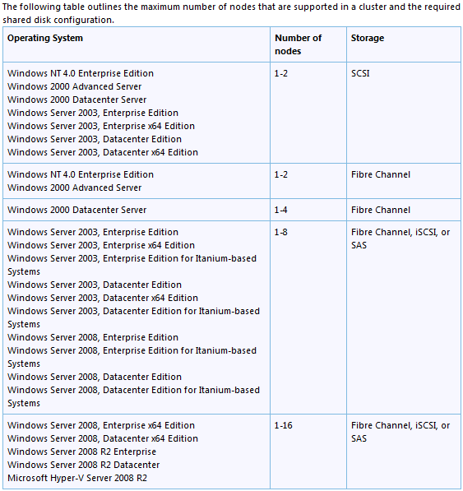
Platform Selection Considerations
OS
  Linux (almost no limitation)
  Windows Server
  Solaris
  AIX
  …
Application server
  Apache
  Tomcat
  Jboss
  Resin
  Weblogic
  …
Notes:
数据来自http://support.microsoft.com/kb/288778/
51CTO集群专题http://network.51cto.com/art/201101/241997.htm

Slide 55





Platform Selection Considerations
Load Balancer
  Hardware
    F5 Networks BigIP
    Cisco
    Radware AppDirector
    …
  Software
    Nignx
    Linux Virtual Server (LVS)
    HAProxy
    …
Failover
  Keepalived
  Heatbeat
  …

Slide 56
Platform Selection Considerations
Programming Languages and Frameworks
  Dynamic languages are slower than static languages
  Compiled code runs faster than interpreted code -> use accelerators or pre-compilers
  Frameworks that provide Dependency Injections, Reflection, Annotations have a marginal performance impact
  ORMs hide DB querying which can in some cases result in poor query performance due to non-optimized querying
RDBMS
  MySQL, MSSQL and Oracle support native replication
  Postgres supports replication through 3rd party software
  Oracle supports Real Application Clustering
  MySQL uses locking and arbitration, while Postgres/Oracle use MVCC (MSSQL just recently introduced MVCC)(多版本并发控制)
Cache
  Teracotta vs memcached vs Coherence
Notes:
Multiversion concurrency control (MCC or MVCC), in the database field of computer science, is a concurrency control method commonly used by database management systems to provide concurrent access to the database and in programming languages to implement transactional memory.
For instance, a database will implement updates not by deleting an old piece of data and overwriting it with a new one, but instead by marking the old data as obsolete and adding the newer version. Thus there are multiple versions stored, but only one is the latest. This allows the database to avoid overhead of filling in holes in memory or disk structures but requires (generally) the system to periodically sweep through and delete the old, obsolete data objects. For a document-oriented database such as CouchDB it also allows the system to optimize documents by writing entire documents onto contiguous sections of disk—when updated, the entire document can be re-written rather than bits and pieces cut out or maintained in a linked, non-contiguous database structure.

Slide 57
Tips
All the techniques we learnt today can be applied in any order
Try and incorporate Horizontal DB partitioning by value from the beginning into your design
Loosely couple all modules
Implement a REST-ful framework for easier caching
Perform application sizing ongoingly to ensure optimal utilization of hardware

Slide 58
10.3 大型网站案例
Case Study

Slide 59

案例1： Taobao架构
全球最大C2C网站
2012.4.17日统计数据来自Alexa
  全球排名第14
  约3.8亿PV/日
Notes:
数据统计来自http://www.123cha.com/alexa/taobao.com
引自淘宝技术发展http://blog.sina.com.cn/s/blog_633219970100xazf.html

Slide 60
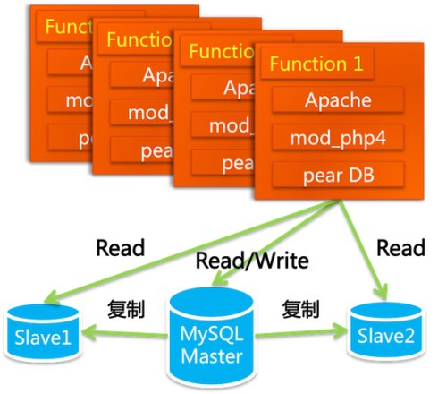

案例1：Taobao架构演化
Taobao V1
  2003.05-2004.01
  2003年4月7日立项,5月10日上线
  2000美元购买PHP源代码+改进
  Apache集群
  mySql集群
  LAMP(linux+apache+mySQL+PHP)
  为了不引起竞争对手注意，对外宣称为个人网站
  从5月到年底成交额4000万，最高每日31万PV

Slide 61
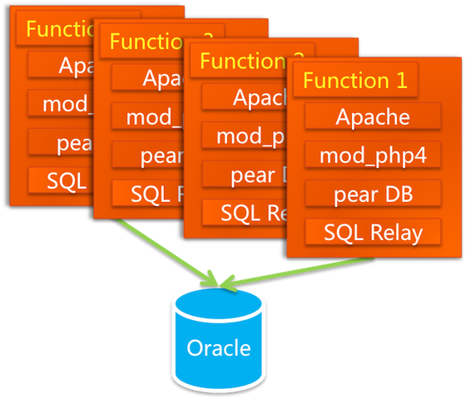
案例1：Taobao架构演化
Taobao V1.1
  2004.01-2004.05
  业务创新(支付宝/旺旺)
  更换数据库
  修改程序(主要是SQL语句)
  增加数据库连接池SQL Relay
  NAS (Network Attached Storage)
  Oracle RAC
  购买小型机

Slide 62
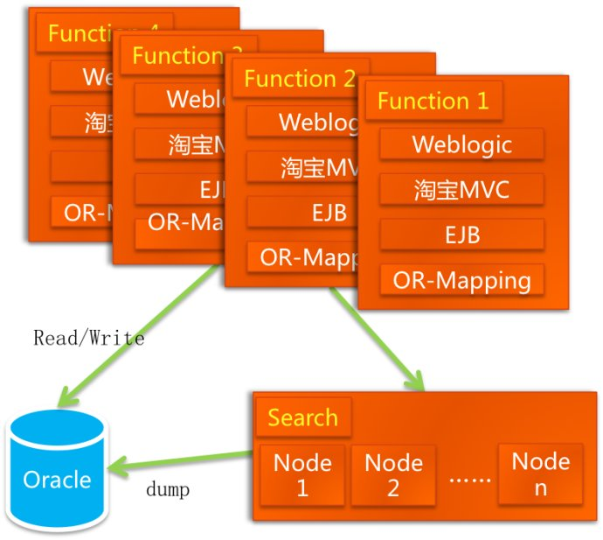
案例1：Taobao架构演化
Taobao V2
  2004.02-2005.03
  PHP→Java
  Sun公司代为开发
  淘宝MVC框架WebX
  EJB
  Apache
  Weblogic
  Ibatis
  搜索引擎isearch(来自阿里巴巴)
  EMC SAN存储区域网络
  数据库服务器升级为IBM小型机

Slide 63
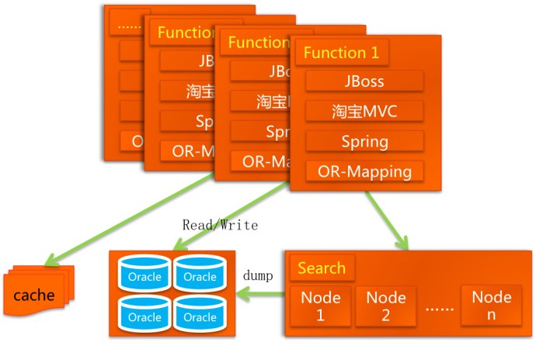
案例1：Taobao架构演化
Taobao V2.1
  2004.10-2007.01
  2005年，商品数有1663万，PV有8931万，注册会员有1390万
  数据库分库（垂直/水平）
    商品库
    用户库1/2
  自己开发中间件DBRoute
  放弃EJB
  引入Spring
  加入缓存TBStore
  自主开发CDN(LVS的创始人章文嵩 )基于squid apache+php lighttpd
  采用开源的Jboss
  加入session框架

Slide 64
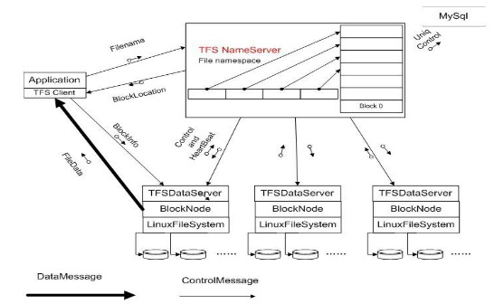
案例1：Taobao架构演化
Taobao V2.2
  2006.10-2007.12
  TFS分布式文件系统
    2007年,TFS上线,200台PC Server，文件数量达到上亿级别；系统部署存储容量：140TB
  分布式缓存TDBM/Tair
  前端页面缓存ESI
  搜索引擎升级(垂直/水平分割)

Slide 65
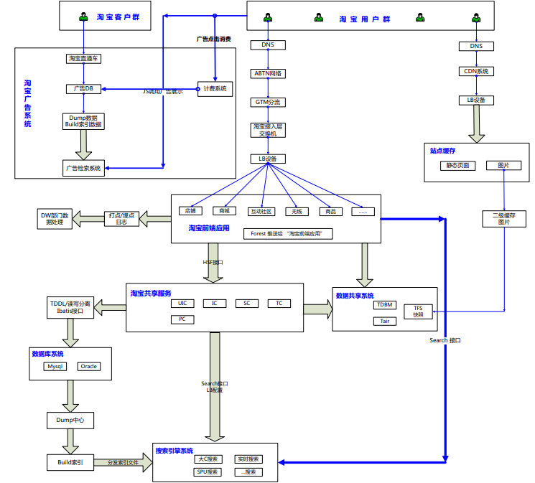
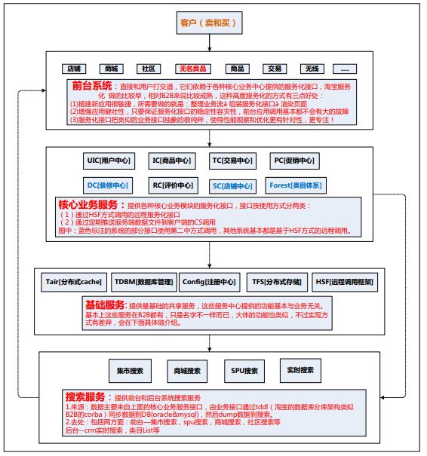
案例1：Taobao架构演化
Taobao V2存在的问题
  多个业务系统重复代码超过1/3
  上百人维护近百万行代码
  考虑数据拆分规则
Taobao V3.0
  2007.12-
  淘宝数据层TDDL
  淘宝面向服务框架HSF
  淘宝消息系统Notify
  非核心数据迁移MySQL
  服务器约2000台
  未来99.999%的可靠性

Slide 66

案例2：YouTube
全球排名第3
约19亿PV/日
2006年数据
  支持每天超过1亿的视频点击量
  2个系统管理员
  2个伸缩性软件架构师
  2个软件开发工程师
  2个网络工程师，1个DBA
Architecture
  NetScaler用于负载均衡和静态内容缓存
  Apache
  使用lighttpd作为Web服务器来提供视频服务
  Python
  psyco，一个动态的Python到C的编译器
  Linux(SuSe)
  MySQL (单服务器→单master和多read slaves →数据库分区→ sharding方式)
  BigTable存储略缩图
  每个视频由一个迷你集群来host，每个视频被超过一台机器持有
  大部分流行的内容移到CDN
2012.4.17统计数据，来自alexa.com
Notes:
http://www.oschina.net/question/12_32459

Slide 67

案例3：天涯社区
全球排名122
约0.17亿PV/日
Architecture
  F5硬件负载均衡
  LVS负载均衡，通过双机热备
  Squid缓存
  Nginx反向代理
  Resin(jsp)+IIS(ASP)
  Memcached
  MySQL(Master-slave)
2012.4.17统计数据，来自alexa.com
Notes:
http://www.oschina.net/question/54100_11157

Slide 68
实验4：集群技术实战

Slide 69
Niginx
Nginx (pronounced engine-x) is a free, open-source, high-performance HTTP server and reverse proxy, as well as an IMAP/POP3 proxy server.
Unlike traditional servers, Nginx doesn't rely on threads to handle requests. Instead it uses a much more scalable event-driven (asynchronous) architecture. This architecture uses small, but more importantly, predictable amounts of memory under load.
Even if you don't expect to handle thousands of simultaneous requests, you can still benefit from Nginx's high-performance and small memory footprint. Nginx scales in all directions: from the smallest VPS (Virtual Private Server) all the way up to clusters of servers.
http://wiki.nginx.org/Main

Slide 70



Niginx+tomcat集群
Internet
Tomcat
Nginx
Internet
Tomcat

Slide 71


Niginx+tomcat+Cobar集群
MemCached
Internet
MySQL
Tomcat
Nginx
Internet
Cobar
MySQL
Tomcat
注意:将HTTPsession存入Memcached中！

Slide 72

Niginx+tomcat+Cobar+MySQL主从集群
Slave
MemCached
MySQL Master
Internet
Tomcat
Nginx
Slave
Internet
Cobar
Tomcat
MySQL Master
Try it!

Slide 73
Memcached开发提示
Niginx+tomcat配置
  http://www.blogjava.net/niumd/archive/2011/05/10/349958.html
Memcached配置实用
  http://www.cnblogs.com/linyu/archive/2011/08/03/2126505.html
Cobar
  http://code.alibabatech.com/wiki/display/cobar/Home
MySQL主子
  http://www.iteye.com/topic/543376
MySQL双主
  http://mysql-mmm.org/start

Slide 74
10.4 “点对点”体系结构风格
Peer-to-Peer (P2P)

Slide 75
Concept of P2P
A peer-to-peer (P2P) architecture is a network that relies primarily on the computing power and bandwidth of the participants in the network rather than concentrating it in a relatively low number of servers. (P2P架构主要依赖于各个参与者自身的计算能力与带宽资源，而不是仅仅依赖于数目较少的几个服务器)
  Pure peer-to-peer (完全的点对点)；
  Hybrid peer-to-peer (混合式的点对点)。

Slide 76
Pure peer-to-peer (完全的点对点)
完全的P2P：
  A pure peer-to-peer network does not have the notion of clients or servers, but only equal peer nodes that simultaneously function as both “clients” and “servers” to the other nodes on the network. (P2P中不存在客户机或服务器的概念，各节点均可充当C/S的角色)
  There is no central server managing the network (不存在中心服务器来管理整个网络)
  There is no central router (也不存在中心路由器)

Slide 77

An example of pure P2P: Gnutella
Gnutella is a file sharing network used primarily to exchange files. (Gnutella：用来进行P2P文件交换的文件共享网络)
  Queries for files are broadcasted on the overlay network, and replies are routed back to the host that originally generated the query through the overlay network. (文件查询请求在网络上广播，查询结果返回给最初发送请求的成员)
  Ping and pong (a reply to a ping) messages are used to discover hosts on the network. (Ping/Pong协议被用来发现网络上的成员)

Slide 78
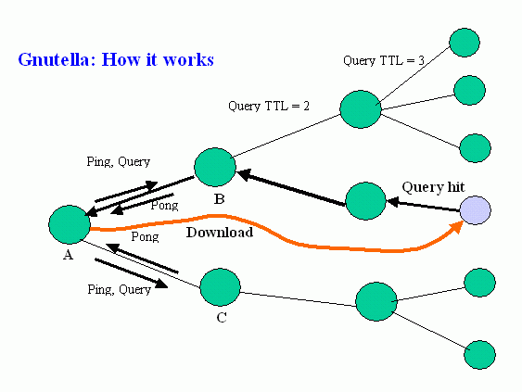
Gnutella: how it works

Slide 79
Gnutella protocol
Gnutella operates on a query flooding protocol.(采用一种“查询泛滥”协议)
  ping: discover hosts on network ("Are you there?")
  pong: reply to ping ("Yes, I am here.")
  query: search for a file ("I am looking for x.")
  query hit: reply to query (“Op, I have the file x!”)
  get/push: request a file provider to contact the requester. (transfer the file x)
The primary disadvantage of this scheme is that the traffic generated by a query increases exponentially with the rarity. (缺点：当文件较少时，造成网络通讯的指数级增长)

Slide 80
Hybrid peer-to-peer (混合式的点对点)
Hybrid P2P (混合P2P)
  Has a central server that keeps information on peers and responds to requests for that information. (具有一个中心服务器，保存各个成员的信息，并对查询给出响应)
  Peers are responsible for hosting available resources (as the central server does not have them), for letting the central server know what resources they want to share, and for making its shareable resources available to peers that request it. (各成员负责提供资源，并将这些共享资源的信息提供给中心服务器)
  Route terminals are used addresses, which are referenced by a set of indices to obtain an absolute address. (路由终端被用来寻址，以找到共享资源的绝对地址)

Slide 81

An example of hybrid P2P: Napster
Napster is an online music service which was originally a file sharing service; (在线音乐服务)
Napster was the first widely-used P2P music sharing service (mp3); (第一个采用P2P结构的mp3共享服务)
In 2002, leading to the music industry‘s accusations of massive copyright violations and shut down by court order. (因为违背版权法而被关闭)
Napster
A legendary icon

Slide 82
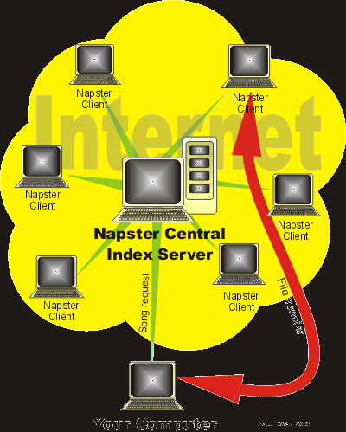
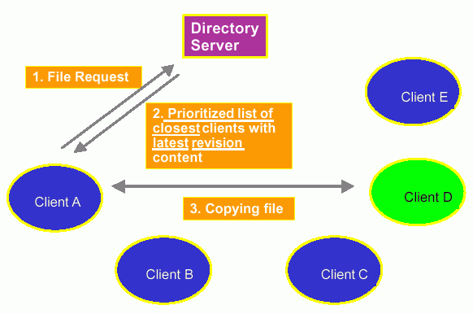
Napster: How it works

Slide 83
结束

